Slide 1
Who is Dura-Lite™ ?
We manufacturer top quality cooling products
In business for over 30 years!
Best known for Evolution® Charge Air Coolers (a.k.a. CAC’s)

Slide 2
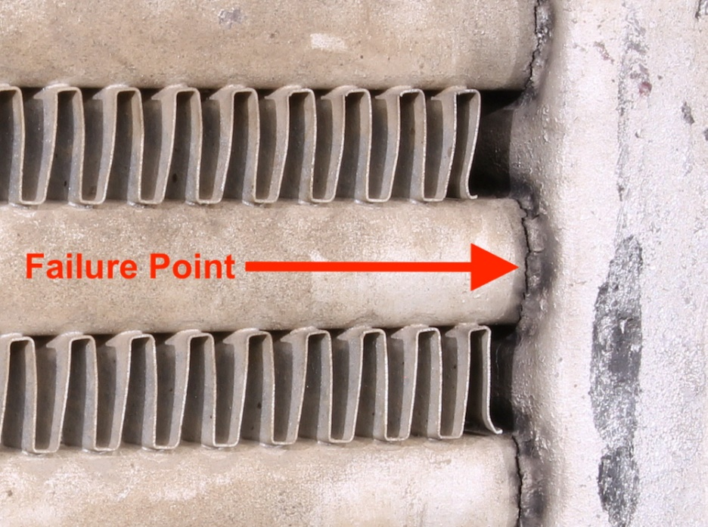
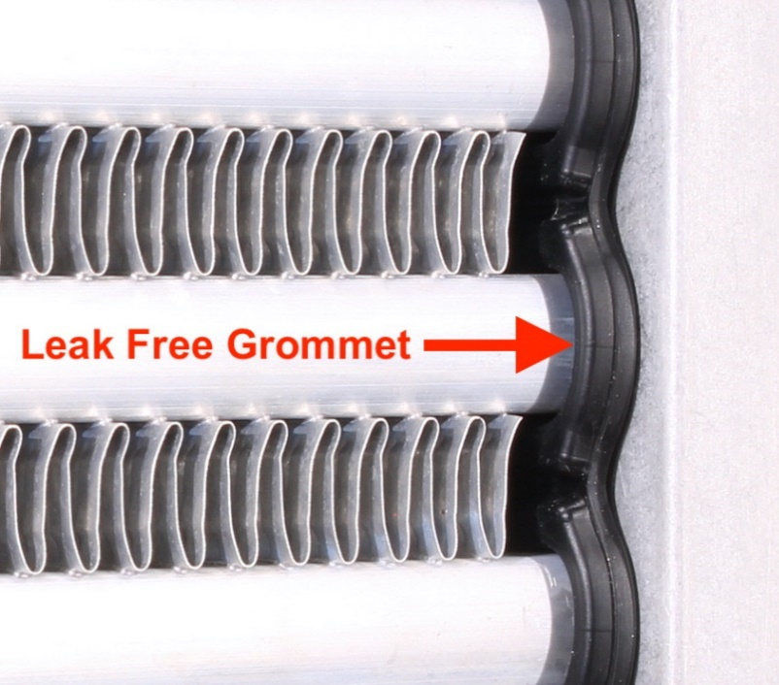
Other CAC’s
Evolution® CAC Difference
Evolution®
Tube to header joints in a standard CAC are rigid. They are unable to expand and contract without eventually cracking.
The result: A LEAKING COOLER.
In an Evolution® CAC, all of the movement is absorbed by the patented, flexible, high-temperature, silicone grommets.
The result: NO CRACKS & NO LEAKS.

Slide 3
Leaks are sneaks!
Most leaks cannot be heard over engine noise.
Most cracks can’t be seen.
So, if a truck has any of the following symptoms:
Poor Fuel Economy
Low Power
Overheating issues
DPF Issues
TEST THE CAC!

Slide 4
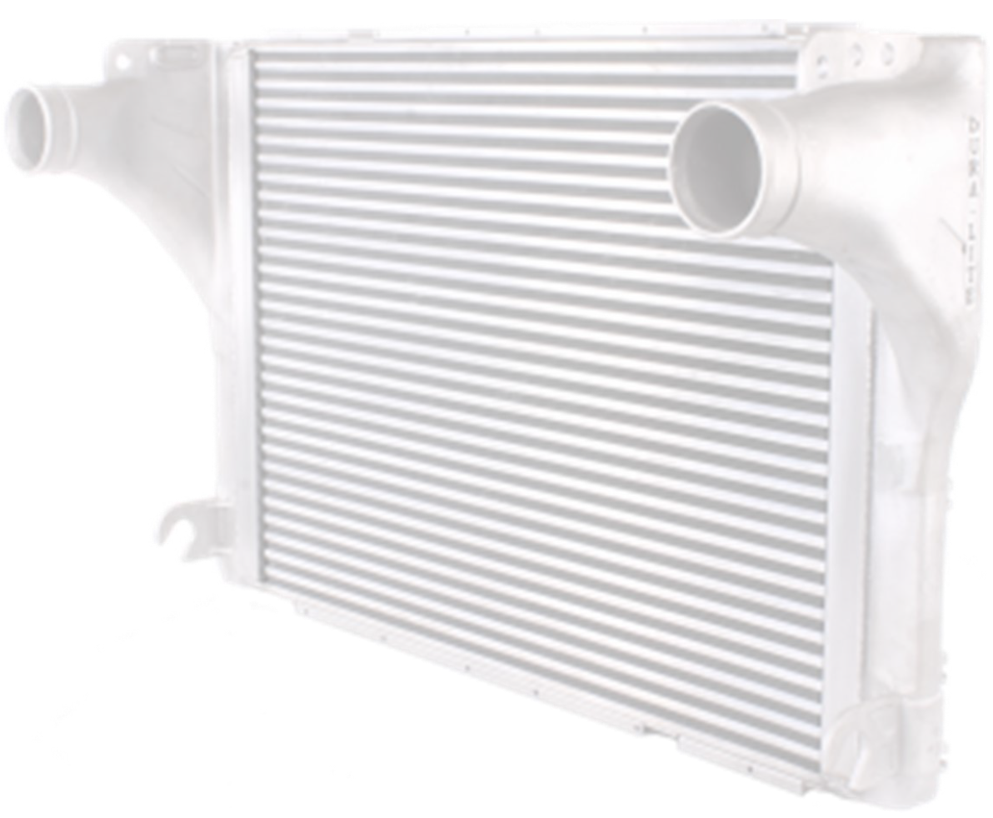
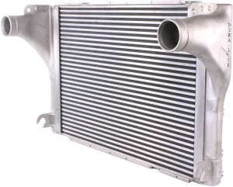
What makes the Evolution® CAC better?
Patented High Temp Silicone Grommet Seal System
Internally reinforced tank support system
Manufactured 100% leak free
Dyno tested to optimize performance
EPA Certified
7 Year – 1 Million Mile Warranty

Slide 5
Literature

Slide 6
Literature
4 out of 10
tube & fin coolers will fail sometime within TWO years!
Less than 1 out of 100
Dura - Lite Evolution coolers will fail in a SEVEN year window

Slide 7
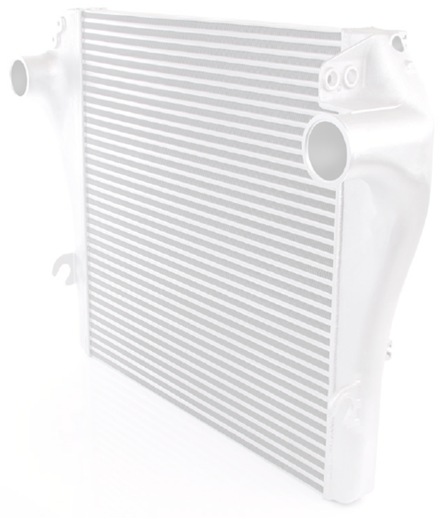
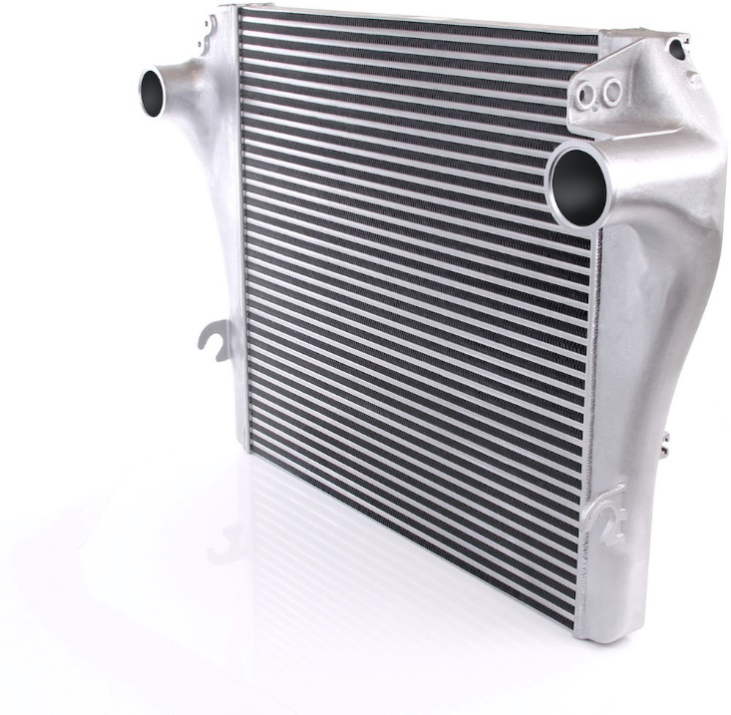
Eliminator® CAC
Engineered as a direct OE replacement
Meet or exceed the OE heat transfer performance
Superior to other aftermarket and OE coolers
The most economical Dura-Lite option
1-year, unlimited-mileage North American warranty

Slide 8
Contact:
?
Customer Support
1-800-661-1117
customersupport@duralite.net
Brad Menyes
Sales & Marketing Manager
403-998-4999
bradm@duralite.net

