Slide 1
Trailer Tracks 150
TT150

Slide 2
Trailer Tracks 150

Slide 3
Market Challenge
Searching for trailers increases driver time and fuel cost
Lack of visibility into trailer locations and trailer status. Loss of trailers and cargo, underutilization, and wasted driver time and fuel searching for empty, usable trailers cuts into profits.
Notes:
Time and fuel cost of searching for trailers.
Underutilization of trailers causes overinflated growth of fleet size, increasing maintenance costs and capital outlay.

Slide 4
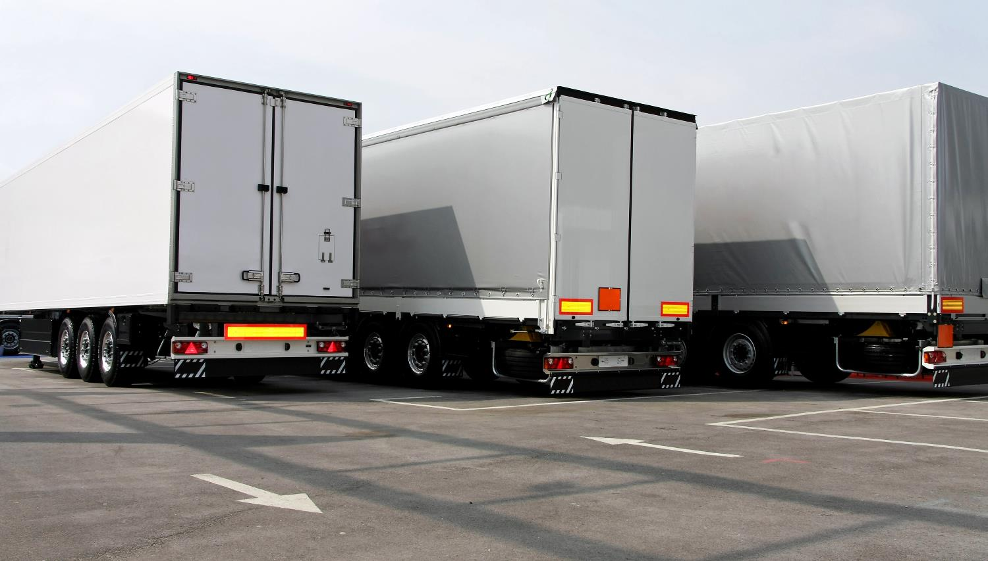
Market Challenge
Not having up-to-the-minute asset status
In addition, trailers that are in set locations and are not constantly monitored are susceptible to theft and misuse.
Notes:
Not having current status information makes trailers susceptible to theft and misuse.

Slide 5
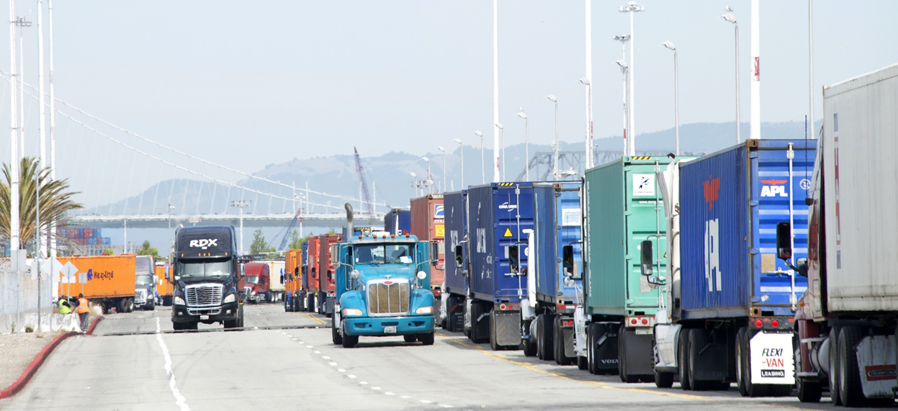
Trailer Tracks 150
Affordable solution to track trailers and cargo
Cost efficient solution that helps fleets manage the location and status of their trailers, which increases operational efficiency and fleet profitability by improving asset visibility
Notes:
TT150 is a cost-efficient solution, tracking location and status of trailers.
Through improved asset visibility, such as dormancy and utilization reporting, fleets can increase operational efficiency and profitability.

Slide 6
Unique Selling Point
Keep track of trailer mileage
Provides an affordable solution to locate your trailers and keep your cargo safe. It also offers trailer mileage data to support proper maintenance and longer life for trailers.
Notes:
Trailer Mileage data helps streamline maintenance planning, reducing time off the road for a fleet.

Slide 7
Features
TT150
Position and event reporting in the US, Canada, and Mexico
Trailer inventory by landmark
Over-the-air firmware upgrades
Integration with existing dispatch software
Automated email alerts based on conditions that you set
Notes:
Many features similar to the TT210.
Position/Event Reporting – US Canada Mexico all for one price, Fully Configurable
Default position reports 15 min while connected to power, 1/day when disconnected
Over-the-air Firmware upgrades – Both Firmware and Script, similar to the MCP having O/S and Apps.

Slide 8
Features
TT150
Configurable reporting
Detect trailer drops at unauthorized locations
Record unauthorized location exit and entrance (Server-based geo-fence Phase 1, Device-based geo-fence Phase 2)
Start/end of trip reporting (Phase 2)
Notes:
Unauthorized Location Entry - (Server-based geo-fence Phase 1, Device-based geo-fence Phase 2)
Trailer Drops – Power on/off reporting

Slide 9
Features
TT150
Supports Trailer Mileage Reporting
Geo-fencing capabilities
5 yr. battery life
Low battery status reporting
Easy peel and stick installation
Notes:
Battery should last 60-90+ days at once/day messaging before needing a recharge. This is dependent on environmental conditions.

Slide 10
Benefits
TT150
Monitor the status and location of trailers and containers in near real-time
Increase asset and cargo security
Increase driver and tractor productivity
Reduce wasted fuel searching for trailers
Monitor unauthorized use of trailers for storage

Slide 11
Benefits
TT150
Optimize asset utilization and trailer pool inventory
Enhance detention billing and improve carrier accountability
Create valuable reports for operations and planning

Slide 12
Benefits
TT150
Improve customer service with accurate and timely information
Maintain visibility in harsh environments
Provides mileage records to support proper maintenance schedule for trailers
Notes:
Explain Connect/Disconnect Power Messages
We DO have a method for Trailer ID with TT150. Trailer ABS Connects, now works on J-1939 with MCP50, 110/200, IVG (TDB)

Slide 13
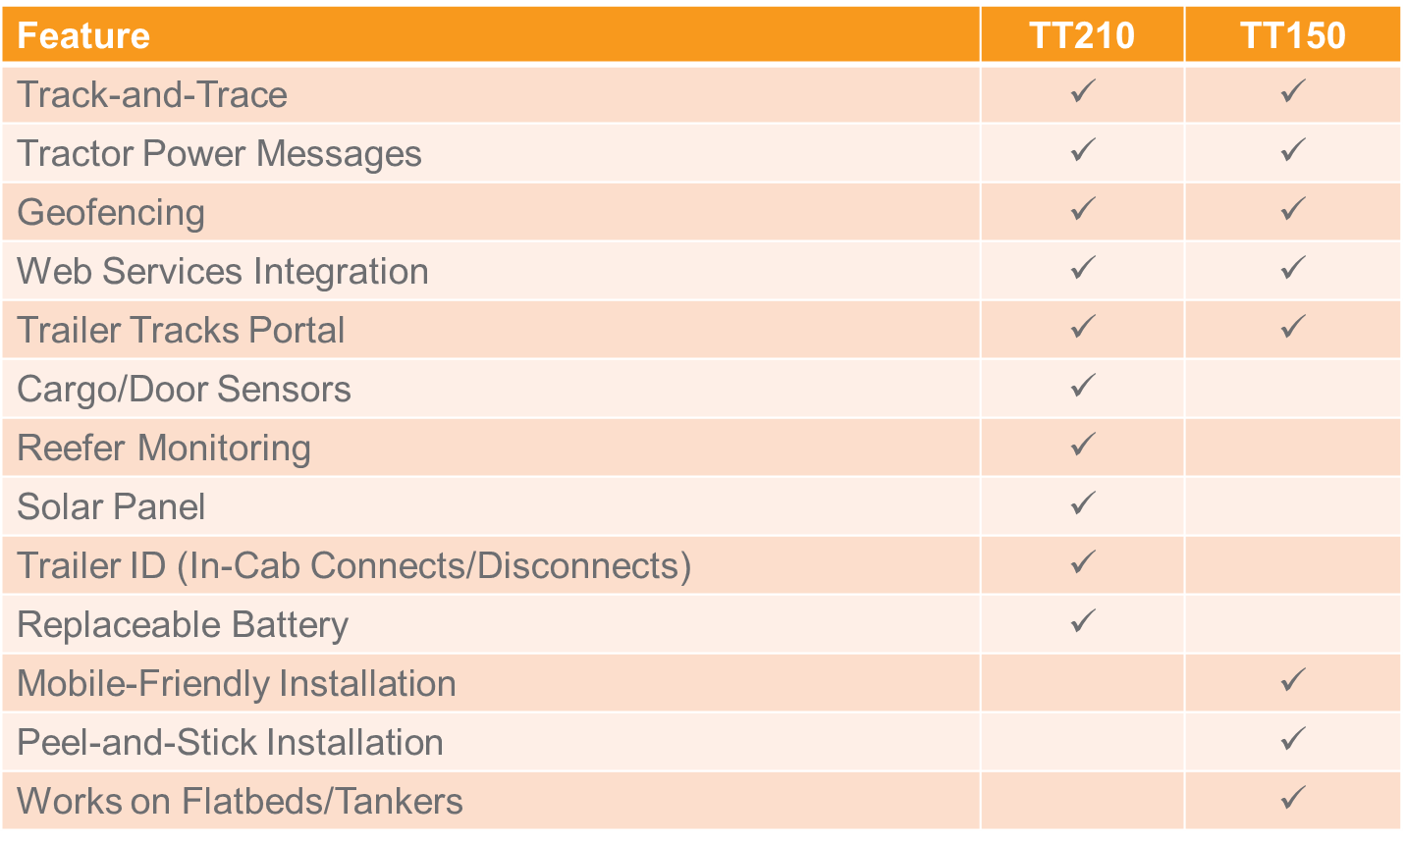
How is TT150 different?
TT210 vs. TT150

Slide 14
Return on Investment
Affordable solution with a high ROI
Reduce the number of on-duty hours spent searching for trailers
Reduce fuel expenses searching for trailers
Reduce trailer idle time
Reduce the number of incorrect trailer pick-ups

Slide 15
TT150
Main Unit

Slide 16
TT150
Complete Kit

